Slide 1

KLE TECHNOLOGICAL UNIVERSITY, HUBLI
School of Electronics & Communication Engineering
Review-1 seminar on
“SQUARE ROOT OF FPGA”
GUIDE: DR.SAROJA V SIDDAMAL(Professor)
Presented By
Aishwarya I Patil 01FE21MVE010

Slide 2
INDEX
ALGORITHM
INTRODUCTION
SQUARE ROOT OF “FPGA”
PROBLEM STATEMENT
EXAMPLES
BLOCK DIAGRAM
LITERATURE SURVEY

Slide 3
INTRODUCTION
The square root function is important elementary function in the scientific calculations, digital signal and image processing.
The field programmable gate arrays (FPGAs) are expanded for solving the problems, where the function √ 𝑥 calculations are of demand.
There are different IP cores of the function √ 𝑥, which are proposed by the FPGA manufacturers.
An improved algorithm of the function √ 𝑥 is proposed, which is suitable for the FPGA implementation.

Slide 4
PROBLEM STATEMENT
Square root is one of the mathematical operations which are widely used in digital signal processing. Its implementation on hardware such as FPGA will provide several advantages compare to the performance offered in software.
Field Programmable Gate Array (FPGA) in order to achieve high speed computation. The main interest of implementing square root calculation is to reduce the delays present in its computation.

Slide 5
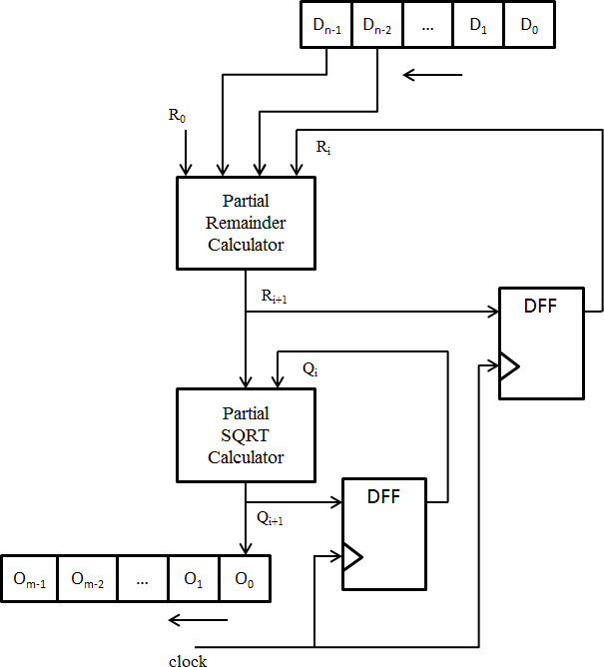
BLOCK DIAGRAM

Slide 6
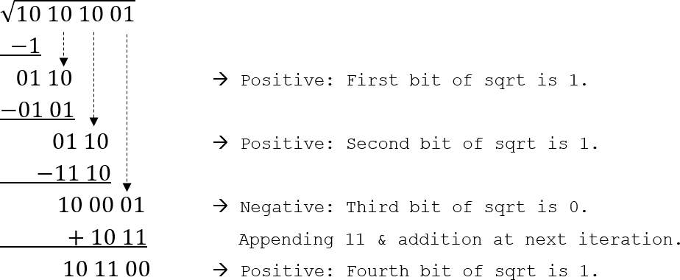

EXAMPLE

Slide 7
ALGORITHM
x[0] = x;
y[0] = x;
for (i = 0; i < n/2; i++)
{
q = xi + 2^(-i+1)*x[i] + 2^(-2i)*x[i];
if (q < 1.0) {x[i+1] = q;
y[i+1] = y[i] + 2^[-i]*y[i];
}
else
{
x[i+1] = x[i]; y[i+1] = y[i];
}
y = y[n/2] + y[n/2]*(1.0 - x[n/2])/2;

Slide 8
THANK YOU

